Slide 1
Monte Carlo on Ice: How Simulation can Help Figure Skating Medalist
James Lee (jlee73@ncsu.edu)

Slide 2
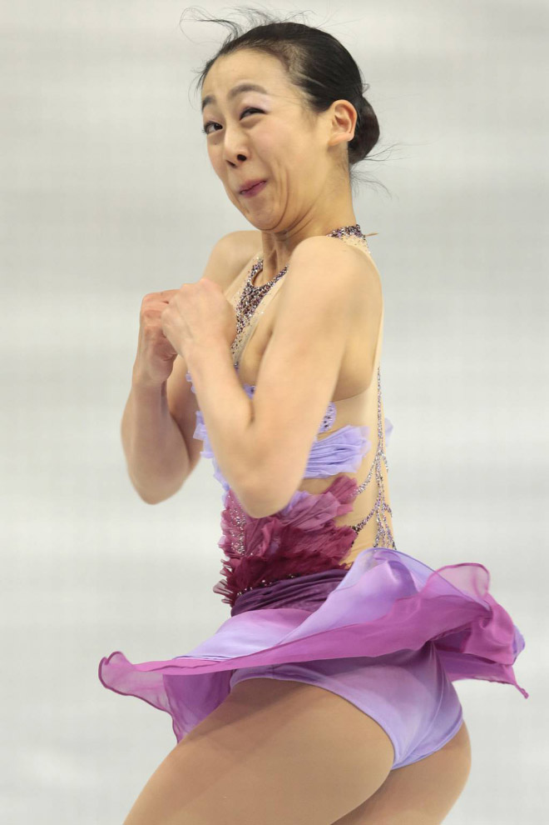
Why doing this project?
More Memes

Slide 3
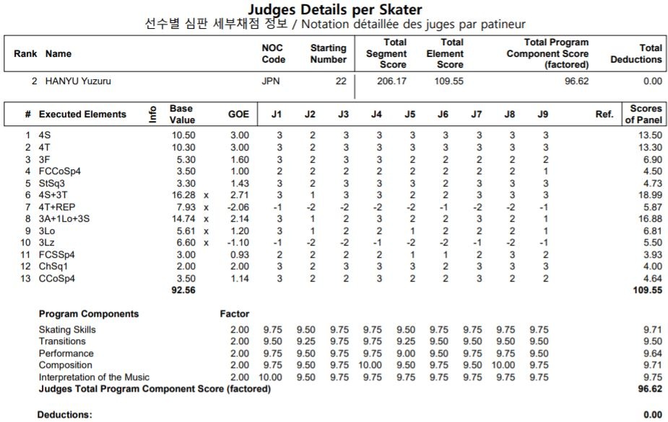
How figure skating is scored

Slide 4
Purpose and Impact
Purpose
More objective and make every jump accountable for.
Limitation on aesthetic scoring (AES)
Impact
Rewarding high based-value jumps (4Lo, 3A…)
Back-loading

Slide 5
Which jump is better?

Slide 6
Back-loading
Getting 10% more BV if jumps are performed in second half

Slide 7
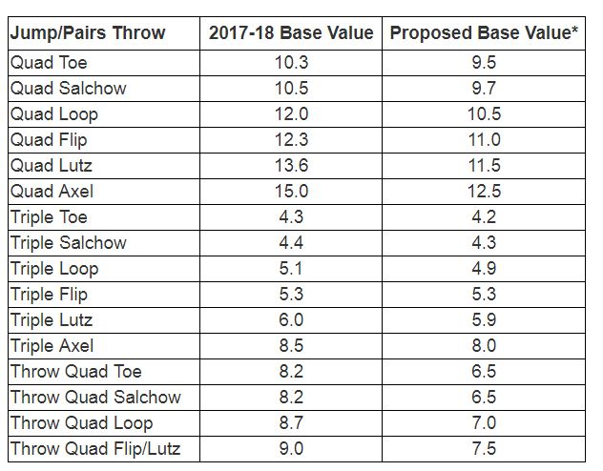
Recent rule changes
Base value change
Extended GOE
(-3~+3 → -5~+5)

Slide 8
Agenda
Method
Benchmark
Comparisons
Results
Review Cases

Slide 9
Method

Slide 10
Benchmark

Slide 11
Comparisons

Slide 12
Results

Slide 13
Case 1:

Slide 14
Case 2:

Slide 15
The End!

